Slide 1
Topic D - Fields D.1 Gravitational fields (SL)
Guiding questions
How are the properties of a gravitational field quantified?
How does an understanding of gravitational fields allow for humans to explore the solar system?
Notes:
© 2006 By Timothy K. Lund

Slide 2
Topic D - Fields D.1 Gravitational fields (SL)
Understandings:
• Kepler’s three laws of orbital motion ***
• Newton's universal law of gravitation as given by F = Gm₁m₂/r² for bodies treated as point masses
• conditions under which extended bodies can be treated as point masses
• that gravitational field strength g at a point is the force per unit mass experienced by a small point mass at that point as given by g = F/m = GM=/r²
• gravitational field lines.
Notes:
© 2006 By Timothy K. Lund

Slide 3
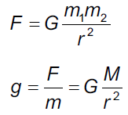
Topic D - Fields D.1 Gravitational fields (SL)
Data booklet reference:
Notes:
© 2006 By Timothy K. Lund

Slide 4


Topic D - Fields D.1 Gravitational fields (SL)
Newton’s law of gravitation
∙The gravitational force is the weakest of the four fundamental forces, as the following visual shows:
ELECTRO-WEAK
ELECTROMAGNETIC
GRAVITY
STRONG
WEAK
+
+
nuclear
force
light, heat, charge and magnets
radioactivity
freefall, orbits
STRONGEST
WEAKEST
Notes:
© 2006 By Timothy K. Lund

Slide 5
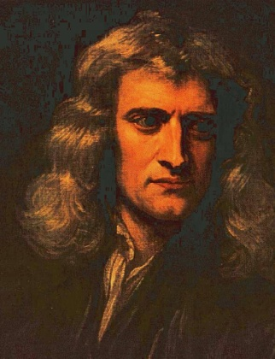
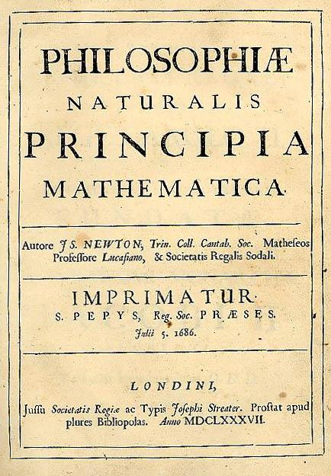
Topic D - Fields D.1 Gravitational fields (SL)
Newton’s law of gravitation
∙In 1687 Isaac Newton published what has been called by some the greatest scientific discovery of all time – his universal law of gravitation.
∙The law states that the gravitational force between two point masses m₁ and m₂ is proportional to their product, and inversely proportional to the square of their separation r.
∙The actual value of G, the universal gravitational constant, was not known until Henry Cavendish conducted a tricky experiment in 1798 to find it.
F = Gm₁m₂ / r ²
Universal law of gravitation
where G = 6.67×10⁻¹¹ N m² kg⁻²
Notes:
© 2006 By Timothy K. Lund

Slide 6
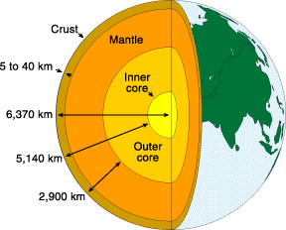
Topic D - Fields D.1 Gravitational fields (SL)
Newton’s law of gravitation
∙The Earth, planets, moons, and even the sun, have many layers – kind of like an onion:
∙In other words, NONE of the celestial bodies we observe are point masses.
∙Given that the law is called the universal law of gravitation, how do we use it for planets and such?
Notes:
© 2006 By Timothy K. Lund

Slide 7
Topic D - Fields D.1 Gravitational fields (SL)
Newton’s law of gravitation
∙Newton spent much time developing integral calculus to prove that
“A spherically symmetric shell of mass M acts as if all of its mass is located at its center.”
∙Thus F = Gm₁m₂ / r ² works not only for point masses, which have no radii, but for any spherically symmetric distribution of mass at any radius like planets and stars.
M
-Newton’s shell theorem.
m
r
Notes:
© 2006 By Timothy K. Lund

Slide 8
Topic D - Fields D.1 Gravitational fields (SL)
Solving problems involving gravitational force
∙As we have said, the earth has four shells:
∙Assuming that each shell is symmetric, the gravitational force caused by that shell acts as though its mass is all concentrated at its center.
∙The net force at m caused by the shells is given by
F = GM_{I}m / r ² + GM_{O}m / r ² + GM_{M}m / r ² + GM_{C}m / r ²
F = G( M_{I} + M_{O} + M_{M} + M_{C} )m / r ²
∙Thus F = GMm / r ² where M = M_{I} + M_{O} + M_{M} + M_{C}.
∙Note that M is just the total mass of the earth.
crust M_{C}
mantle M_{M}
m
outer core M_{O}
inner core M_{I}
r
Notes:
© 2006 By Timothy K. Lund

Slide 9
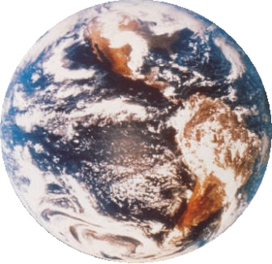
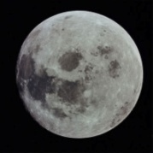
Topic D - Fields D.1 Gravitational fields (SL)
Solving problems involving gravitational force
∙Be very clear that r is the distance between the centers of the masses.
FYI
∙The radius of each mass is immaterial.
m₁
m₂
F₁₂
F₂₁
r
EXAMPLE: The earth has a mass of M = 5.98×10²⁴ kg and the moon has a mass of m = 7.36×10²² kg. The mean distance between the earth and the moon is 3.82×10⁸ m. What is the gravitational force between them?
SOLUTION: Use F = GMm / r ².
F = (6.67×10⁻¹¹)(5.98×10²⁴ )(7.36×10²² ) / (3.82×10⁸)²
F = 2.01×10²⁰ N.
Notes:
© 2006 By Timothy K. Lund

Slide 10
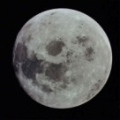
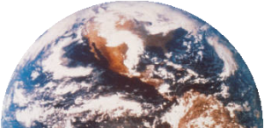
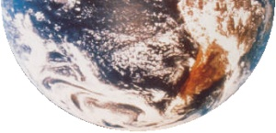
Topic D - Fields D.1 Gravitational fields (SL)
Solving problems involving gravitational force
EXAMPLE: The moon has a mass of m = 7.36×10²² kg. The mean distance between the earth and the moon is 3.82×10⁸ m. What is the speed of the moon in its orbit about earth?
SOLUTION: Use F_{C} = F_{G} = mv ² / r .
∙From the previous slide F_{G} = 2.01×10²⁰ N. Then
2.01×10²⁰ = ( 7.36×10²² ) v ² / 3.82×10⁸
∙Then v = 1.02×10³ ms⁻¹.
FYI
∙For circular orbits, the gravitational force is the centripetal force. Thus F_{C} = F_{G}.
Notes:
© 2006 By Timothy K. Lund

Slide 11
Topic D - Fields D.1 Gravitational fields (SL)
Solving problems involving gravitational force
EXAMPLE: The moon has a mass of m = 7.36×10²² kg. The mean distance between the earth and the moon is 3.82×10⁸ m. What is the period of the moon (in days) in its orbit about earth?
SOLUTION: Use v = d / t = 2πr / T.
∙From the previous slide v = 1.02×10³ ms⁻¹. Then
T = 2πr / v = 2π( 3.82×10⁸ ) / 1.02×10³
= (2.35 ×10⁶ s)(1 h / 3600 s)(1 d / 24 h) = 27.2 d.
FYI
∙For circular orbits, the gravitational force is the centripetal force. Thus F_{C} = F_{G}.
Notes:
© 2006 By Timothy K. Lund

Slide 12
Topic D - Fields D.1 Gravitational fields (SL)
Gravitational field strength
∙Suppose a mass m is located a distance r from a another mass M.
∙The gravitational field strength g is the force per unit mass acting on m due to the presence of M. Thus
Question: What is the weight W of a 100 kg person standing on the surface of the Earth?
Answer: F_{g} = mg = (100 kg)(9.8 m s ⁻²) = 980 N
Question: What is the gravitational field strength g where that person stands?
Answer: g = (980 N) / (100 kg) = 9.8 N kg ⁻¹ = 9.8 m s ⁻².
g = F / m
gravitational field strength
Notes:
© 2006 By Timothy K. Lund

Slide 13
Topic D - Fields D.1 Gravitational fields (SL)
Gravitational field strength
∙Suppose a mass m is located a distance r from a another mass M.
∙The gravitational field strength g is the force per unit mass acting on m due to the presence of M. Thus
The units are newtons per kilogram (N kg ⁻¹).
Note that from Newton’s second law, F = ma, we see that a N kg ⁻¹ is also a m s ⁻², the units for acceleration.
Note further that weight has the formula F_{g} = mg, and that the g in this formula is none other than the gravitational field strength!
On the earth’s surface, g = 9.8 N kg ⁻¹ = 9.8 m s ⁻².
g = F / m
gravitational field strength
Notes:
© 2006 By Timothy K. Lund

Slide 14
Topic D - Fields D.1 Gravitational fields (SL)
Solving problems involving gravitational field strength
∙Suppose a mass m is located on the surface of a planet of radius R. We know that it’s weight is F = mg.
∙But from the law of universal gravitation, the weight of m is equal to its attraction to the planet’s mass M and equals F = GMm / R ².
Thus mg = GMm / R ².
This same derivation works for any m or r.
g = GM / R ²
gravitational field strength at surface of a planet of mass M and radius R
g = GM / r ²
gravitational field strength at distance r from center of a mass M
Notes:
© 2006 By Timothy K. Lund

Slide 15
Topic D - Fields D.1 Gravitational fields (SL)
Solving problems involving gravitational field strength
PRACTICE: The mass of the earth is M = 5.98×10²⁴ kg and the radius of the earth is R = 6.37×10⁶ m. Find the gravitational field strength at the surface of the earth, and at a distance of one earth radius above its surface.
SOLUTION:
∙For r = R:
g = GM / R ²
g = (6.67×10⁻¹¹)(5.98×10²⁴)/(6.37×10⁶)²
g = 9.83 N kg⁻¹ (m s⁻²).
∙For r = 2R: Since r is squared…just divide by 2² = 4. Thus
g = 9.83 / 4 = 2.46 m s⁻².
Notes:
© 2006 By Timothy K. Lund

Slide 16
Topic D - Fields D.1 Gravitational fields (SL)
Solving problems involving gravitational field strength
PRACTICE: A 525-kg satellite is launched from the earth’s surface to a height of one earth radius above the surface. What is its weight (a) at the surface, and (b) at altitude?
SOLUTION: Use information from the previous slide:
(a) AT SURFACE: g_{surface} = 9.83 m s⁻².
∙Then from F = mg we get
F = (525)(9.83) = 5160 N.
(b) AT ALTITUDE: g_{surface+R} = 2.46 m s⁻².
∙Then from F = mg we get
F = (525)(2.46) = 1290 N.
Notes:
© 2006 By Timothy K. Lund

Slide 17
Topic D - Fields D.1 Gravitational fields (SL)
Gravitational field strength
∙Compare the gravitational force formula
F = GMm / r ² (Force – action at a distance)
with the gravitational field formula
g = GM / r ² (Field – local curvature of space)
∙Note that the force formula has two masses, and the force is the result of their interaction at a distance r.
Note that the field formula has just one mass – namely the mass that “sets up” the local field in the space surrounding it. It “curves” it.
The field view of the universe (spatial disruption by a single mass) is currently preferred over the force view (action at a distance) as the next slides will show.
Notes:
© 2006 By Timothy K. Lund

Slide 18
Topic D - Fields D.1 Gravitational fields (SL)
Gravitational field strength
∙Consider the force view (action at a distance).
∙In the force view, the masses know the locations of each other at all times, and the force is instantaneously felt by both masses at all times.
∙This requires the “force signal” to be transferred between the masses instantaneously.
∙As we will learn later, Einstein’s special theory of relativity states unequivocally that the fastest any signal can travel is at the (finite) speed of light c.
SUN
Notes:
© 2006 By Timothy K. Lund

Slide 19
Topic D - Fields D.1 Gravitational fields (SL)
Gravitational field strength
∙Thus the action at a distance “force signal” will be slightly delayed in telling the orbital mass when to turn.
∙The end result would have to be an expanding spiral motion, as illustrated in the following animation:
∙We do not observe planets leaving their orbits as they travel around the sun.
∙Thus action at a distance doesn’t work if we are to believe special relativity.
∙And all current evidence points to the correctness of special relativity.
SUN
Notes:
© 2006 By Timothy K. Lund

Slide 20
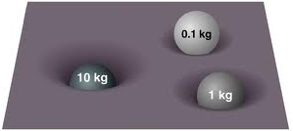
Topic D - Fields D.1 Gravitational fields (SL)
Gravitational field strength
∙So how does the field view take care of this “signal lag” problem?
∙Simply put – the gravitational field distorts the space around the mass that is causing it so that any other mass placed at any position in the field will “know” how to respond immediately.
∙Think of space as a stretched rubber sheet – like a drum head.
∙Bigger masses “curve” the rubber sheet more than smaller masses.
∙The next slide illustrates this gravitational “curvature” of the space surrounding, for example, the sun.
Notes:
© 2006 By Timothy K. Lund

Slide 21
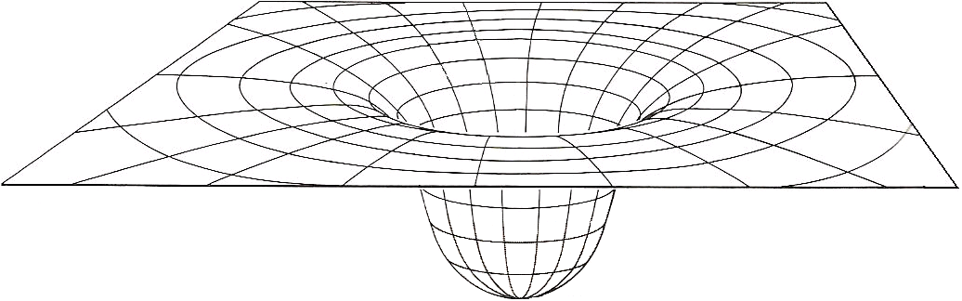
Topic D - Fields D.1 Gravitational fields (SL)
Gravitational field strength
∙Note that each mass “feels” a different “slope” and must travel at a particular speed to stay in orbit.
FYI
∙The field view eliminates the need for long distance signaling between two masses. Rather, it distorts the space about one mass.
Notes:
© 2006 By Timothy K. Lund

Slide 22
Topic D - Fields D.1 Gravitational fields (SL)
Gravitational field strength
∙In the space surrounding the mass M which sets up the field we can release “test masses” m₁ and m₂ as shown to determine the strength of the field.
m₁
m₂
g₁
g₂
(a) Because g = GM / r². It varies as 1 / r².
(b) Because the gravitational force is attractive.
M
FYI
(a) The field arrow is bigger for m₂ than m₁. Why?
(b) The field arrow always points to M. Why?
Notes:
© 2006 By Timothy K. Lund

Slide 23
Topic 6: Circular motion and gravitation 6.2 – Newton’s law of gravitation
Gravitational field strength
∙By “placing” a series of small test masses about a larger mass, we can map out its gravitational field:
M
FYI
∙The field arrows of the inner ring are longer than the field arrows of the outer ring and all field arrows point to the centerline.
Notes:
© 2006 By Timothy K. Lund

Slide 24
Topic D - Fields D.1 Gravitational fields (SL)
Gravitational field strength
∙If we take a top view, and eliminate some of the field arrows, our sketch of the gravitational field is vastly simplified:
∙In fact, we don’t even have to draw the sun – the arrows are sufficient to denote its presence.
∙To simplify field drawings even more, we take the convention of drawing “field lines” as a single arrow.
SUN
SUN
Notes:
© 2006 By Timothy K. Lund

Slide 25
Topic D - Fields D.1 Gravitational fields (SL)
Gravitational field strength
∙In the first sketch the strength of the field at a point is determined by the length of the field arrows in the vicinity of that point.
∙The second sketch has single arrows, so how do we know how strong the field is at a particular point in the vicinity of a mass?
∙We simply look at the concentration of the field lines. The closer together the field lines, the stronger the field.
∙In the red region the field lines are closer together than in the green region.
∙Thus the red field is stronger than the green field.
SUN
SUN
Notes:
© 2006 By Timothy K. Lund

Slide 26



Topic D - Fields D.1 Gravitational fields (SL)
Solving problems involving gravitational field strength
PRACTICE: Sketch the gravitational field about the earth (a) as viewed from far away, and (b) as viewed “locally” (at the surface).
SOLUTION:
(a)
(b)
or
FYI ∙Note that the closer to the surface we are, the more uniform the field concentration.
∙At the surface, the field lines are approx. parallel!
Notes:
© 2006 By Timothy K. Lund

Slide 27
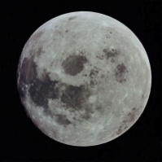
Topic D - Fields D.1 Gravitational fields (SL)
Solving problems involving gravitational field strength
EXAMPLE: Find the gravitational field strength at a point between the earth and the moon that is right between their centers.
SOLUTION:
∙Make a sketch.
∙Note that r = d / 2 = 3.82×10⁸ / 2 = 1.91 ×10⁸ m.
∙g_{m} = Gm / r ²
g_{m} = (6.67×10⁻¹¹)(7.36×10²²)/(1.91×10⁸)² = 1.35×10⁻⁴ N kg ⁻¹
∙g_{M} = GM / r ²
g_{M} = (6.67×10⁻¹¹)(5.98×10²⁴)/(1.91×10⁸)² = 1.09×10⁻² N kg ⁻¹
∙Finally, g = g_{M} – g_{m} = 1.08×10 ⁻² N kg ⁻¹,→
M = 5.98×10²⁴ kg
m = 7.36×10²² kg
g_{m}
g_{M}
d = 3.82×10⁸ m
Notes:
© 2006 By Timothy K. Lund

Slide 28
Topic D - Fields D.1 Gravitational fields (SL)
Solving problems involving gravitational field strength
PRACTICE: Jupiter’s gravitational field strength at its surface is 25 N kg⁻¹ while its radius is 7.1×10⁷ m.
(a) Derive an expression for the gravitational field strength at the surface of a planet in terms of its mass M and radius R and the gravitational constant G.
SOLUTION: This is for a general planet…
(a) F = Gm₁m₂ / r ² (law of universal gravitation)
F = GMm₂ / R ² (substitution)
g = F / m₂ (gravitational field definition)
g = (GMm₂ / R ²)/ m₂(substitution)
g = GM / R ²
Notes:
© 2006 By Timothy K. Lund

Slide 29
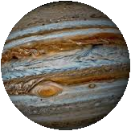
Topic D - Fields D.1 Gravitational fields (SL)
Solving problems involving gravitational field strength
PRACTICE: Jupiter’s gravitational field strength at its surface is 25 N kg⁻¹ while its radius is 7.1×10⁷ m.
(b) Using the given information and the formula you just derived deduce Jupiter’s mass.
(c) Find the weight of a 65-kg man on Jupiter.
SOLUTION:
(b) g = GM / R ² (just derived in (a))
M = gR ² / G (manipulation)
M = (25)(7.1×10⁷)² / 6.67×10⁻¹¹ = 1.9×10²⁷ kg.
(c) F = mg
F = 65(25) = 1600 N.
Notes:
© 2006 By Timothy K. Lund

Slide 30
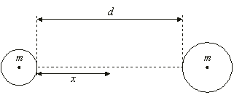
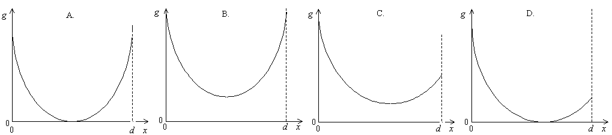
Topic D - Fields D.1 Gravitational fields (SL)
Solving problems involving gravitational field strength
PRACTICE: Two spheres of equal mass and different radii are held a distance d apart. The gravitational field strength is measured on the line joining the two masses at position x which varies. Which graph shows the variation of g with x correctly?
∙There is a point between M and m where g = 0.
∙Since g = Gm / R ² and R_{left} < R_{right}, then g_{left} > g_{right} at the surfaces of the masses.
Notes:
© 2006 By Timothy K. Lund

Slide 31
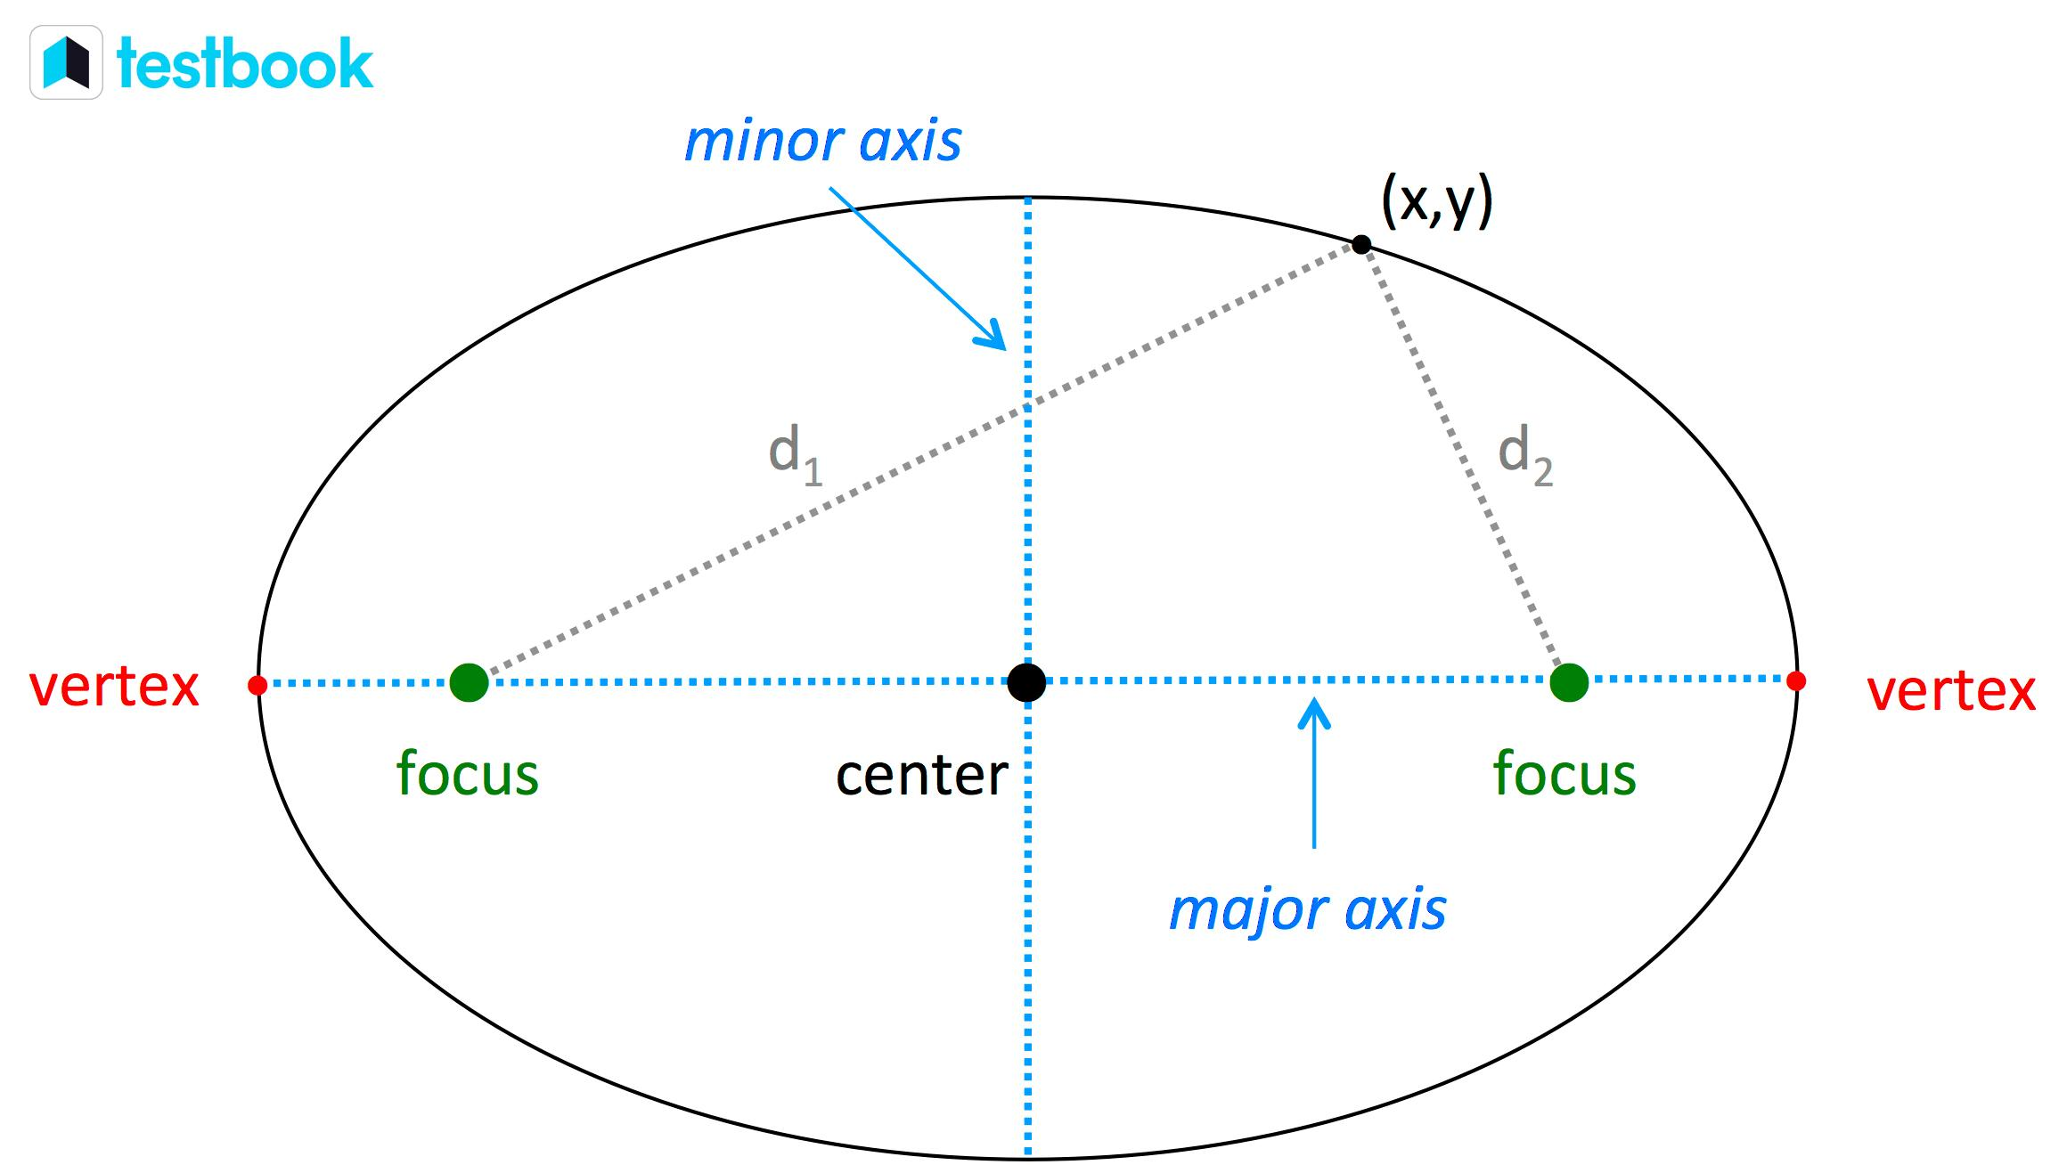
Topic D - Fields D.1 Gravitational fields (SL)
Kepler’s Laws
In reality, orbits are not perfect circles. The shape of an orbit is actually an ellipse.
An ellipse is formed when a point (x,y) is traced around two focus points (called “foci”) where the sum of the distances between the point and each focus (d₁+d₂) remains constant.
Notes:
© 2006 By Timothy K. Lund

Slide 32
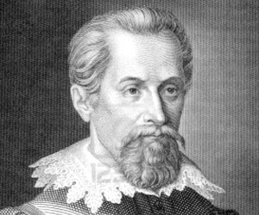
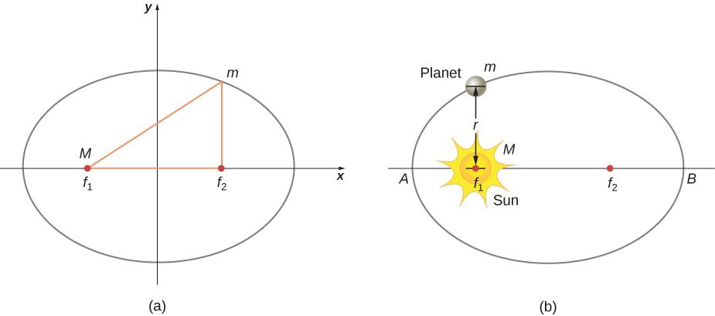
Topic D - Fields D.1 Gravitational fields (SL)
Kepler’s Laws
Johannes Kepler, a German astronomer and mathematician, developed 3 Laws of Planetary Motion that described how planets orbit stars.
Kepler’s 1st Law: explains that planets are orbiting the sun in a path described as an ellipse, and the sun is located at one focus.
Notes:
© 2006 By Timothy K. Lund

Slide 33
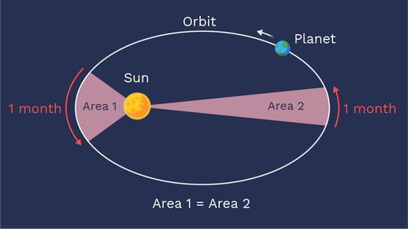
Topic D - Fields D.1 Gravitational fields (SL)
Kepler’s Laws
Kepler’s 2nd Law: describes the speed at which any given planet will move while orbiting the sun. A planet moves fastest when it is closest to the sun and slowest when it is furthest from the sun. Yet, if an imaginary line were drawn from the center of the planet to the center of the sun, that line would sweep out the same area in equal periods of time.
Notes:
© 2006 By Timothy K. Lund

Slide 34
Topic D - Fields D.1 Gravitational fields (SL)
Kepler’s Laws
EXAMPLE: Derive Kepler’s 3rd Law, which states that the period T of an object in a circular orbit about a body of mass M is given by T ² = [ (4π² / (GM) ]r ³.
SOLUTION:
∙In circular orbit F_{C} = ma_{C}.
∙From Newton’s law of gravitation F_{C} = GMm / r ².
∙From Topic A.2, a_{C} = 4π²r / T ². Then
ma_{C} = GMm / r ²
4π²r / T ² = GM / r ²
4π²r ³ = GMT ²
T ² = [ 4π² / (GM) ]r ³.
Notes:
© 2006 By Timothy K. Lund

Slide 35
Topic D - Fields D.1 Gravitational fields (SL)
Solving problems involving orbital period
EXAMPLE: A satellite in geosynchronous orbit takes 24 hours to orbit the earth. Thus, it can be above the same point of the earth’s surface at all times, if desired. Find the necessary orbital radius, and express it in terms of earth radii. R_{E} = 6.37×10⁶ m.
SOLUTION: T = (24 h)(3600 s h⁻¹) = 86400 s.
∙Then from Kepler’s law T ² = [ 4π² / (GM) ]r ³ we have
r ³ = T ²/ [ 4π² / (GM) ]
r ³ = 86400 ²/ [ 4π² / (6.67×10⁻¹¹×5.98×10²⁴) ]
= 7.54×10²²
r = (42250474 m)(1 R_{E} / 6.37×10⁶ m) = 6.63 R_{E}.
Notes:
© 2006 By Timothy K. Lund

Slide 36

Topic D - Fields D.1 Gravitational fields (SL)
Solving problems involving orbital period
T ² = [ 4π²/ (GM) ]r ³
Kepler’s third law
∙T ² = [ 4π²/ (GM) ]R ³ → R ³ = [GM / (4π²)] ⁻¹ T ².
∙R ³ ∝ T ² with 1 / [ GM / (4π²) ] being the constant of proportionality.
FYI
∙Kepler’s third law originally said that the square of the period was proportional to the cube of the radius – and nothing at all about what the constant of proportionality was. Newton’s law of gravitation was needed for that!
Notes:
© 2006 By Timothy K. Lund

Slide 37

Topic D - Fields D.1 Gravitational fields (SL)
Solving problems involving orbital period
T ² = [ 4π²/ (GM) ]r ³
Kepler’s third law
∙T ² = [ 4π² / (GM) ]r ³
T = { [ 4π²/ (GM) ]r ³ ] }^{1/2}
T = [ 4π²/ (GM) ] ^{1/2} r ^{3/2}
∙Thus T ∝ r ^{3/2}.
Notes:
© 2006 By Timothy K. Lund

Slide 38

Topic D - Fields D.1 Gravitational fields (SL)
Solving problems involving orbital period
T ² = [ 4π²/ (GM) ]r ³
Kepler’s third law
∙T_{X}² = [ 4π²/ (GM) ]r_{X}³.
∙T_{Y}² = [ 4π²/ (GM) ]r_{Y}³.
∙ T_{X} = 8T_{Y} → T_{X}² = 64T_{Y}².
T_{X}²/ T_{Y}² = [ 4π²/ (GM) ] r_{X}³/ { [ 4π²/ (GM) ] r_{Y}³ }
64T_{Y}² / T_{Y}² = r_{X}³ / r_{Y}³
64 = (r_{X} / r_{Y})³
r_{X} / r_{Y} = 64^{1/3} = 4
Notes:
© 2006 By Timothy K. Lund

Slide 39

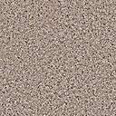
Topic D - Fields D.1 Gravitational fields (SL)
Solving problems involving gravitational field
∙Consider Dobson inside an elevator which is not moving…
∙If he drops a ball, it will accelerate downward at 10 ms⁻² as expected.
PRACTICE: If the elevator is accelerating upward at 2 ms⁻², what will Dobson observe the dropped ball’s acceleration to be?
SOLUTION:
∙Since the elevator is accelerating upward at 2 ms⁻² to meet the ball which is accelerating downward at 10 ms⁻², Dobson would observe an acceleration of 12 ms⁻².
∙If the elevator were accelerating downward at 2, he would observe an acceleration of 8 ms⁻².
Notes:
© 2006 By Timothy K. Lund

Slide 40
Topic D - Fields D.1 Gravitational fields (SL)
Solving problems involving gravitational field
PRACTICE: If the elevator were to accelerate downward at 10 ms⁻², what would Dobson observe the dropped ball’s acceleration to be?
SOLUTION:
∙He would observe the acceleration of the ball to be zero!
∙He would think that the ball was “weightless!”
FYI
∙The ball is NOT weightless, obviously. It is merely accelerating at the same rate as Dobson!
∙How could you get Dobson to accelerate downward at 10 ms⁻²?
Cut the cable!
Notes:
© 2006 By Timothy K. Lund

Slide 41
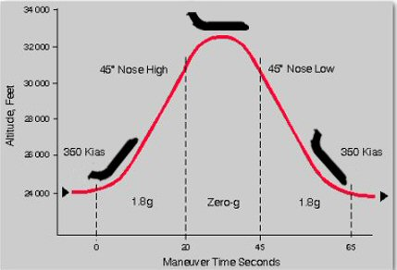
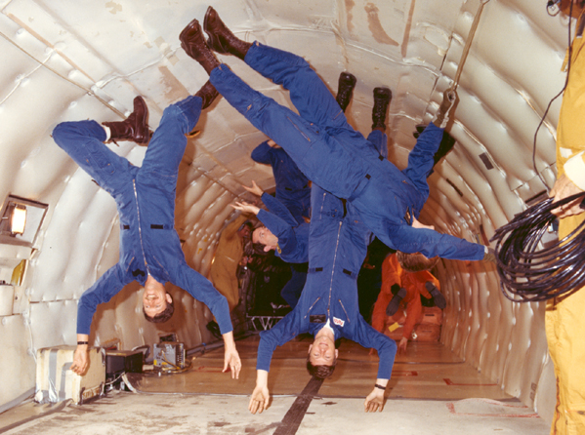
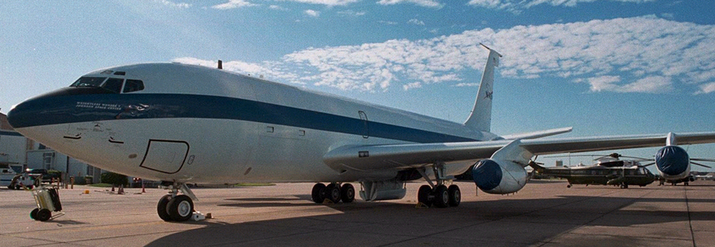
The “Vomit Comet”
Notes:
© 2006 By Timothy K. Lund

Slide 42
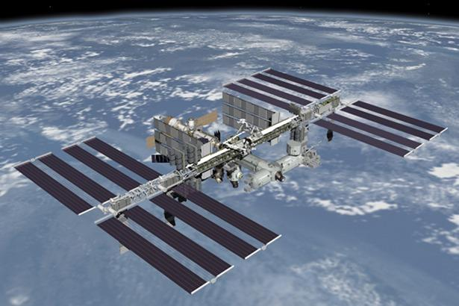
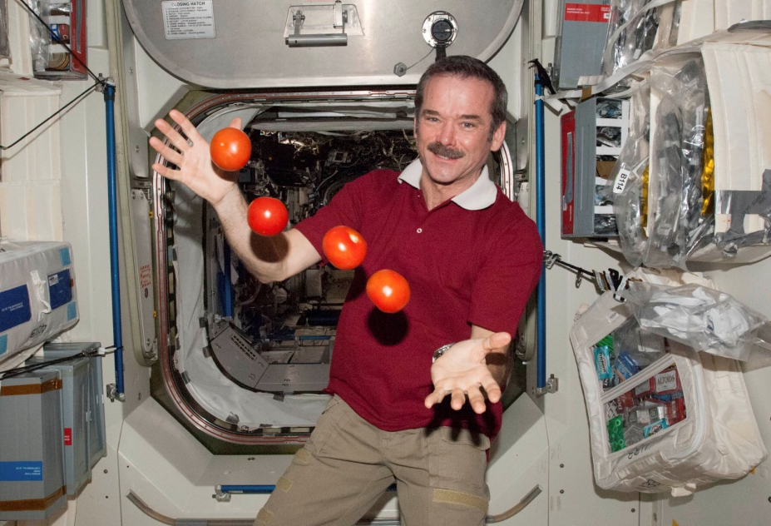
Topic D - Fields D.1 Gravitational fields (SL)
Solving problems involving gravitational field
PRACTICE: We have all seen astronauts experiencing “weightlessness.” Explain why it only appears that they are weightless.
SOLUTION: The astronaut, the spacecraft, and the tomatoes, are all accelerating at a_{c} = g.
∙They all fall together and appear to be weightless.
International Space Station
Notes:
© 2006 By Timothy K. Lund

Slide 43
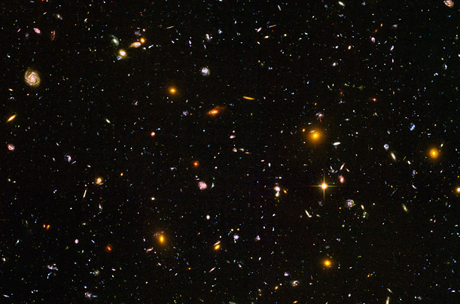
Topic D - Fields D.1 Gravitational fields (SL)
Solving problems involving gravitational field
PRACTICE: Discuss the concept of weightlessness in deep space.
SOLUTION: Only in deep space – which is defined to be far, far away from all masses – will a mass be truly weightless.
∙In deep space, the r in F = GMm / r ² is so large for every m that F, the force of gravity, is for all intents and purposes, zero.
Notes:
© 2006 By Timothy K. Lund

Slide 44

Topic D - Fields D.1 Gravitational fields (SL)
Solving problems involving gravitational field
∙Since the satellite is in circular orbit F_{C} = mv ²/ r.
∙Since the satellite’s weight is holding it in orbit, F_{C} = mg.
∙Thus mv ²/ r = mg.
∙Finally g = v ²/ r.
Notes:
© 2006 By Timothy K. Lund

Slide 45

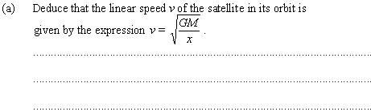
Topic D - Fields D.1 Gravitational fields (SL)
Solving problems involving gravitational field
x
R
∙g = GM / x ²
∙a_{c} = GM / x ² (since a_{c} = g in circular orbits).
∙v ²/ x = GM / x ² (since r = x and a_{c} = v ²/ x).
∙v ² = GM / x so that v = GM / x.
Notes:
© 2006 By Timothy K. Lund

Slide 46
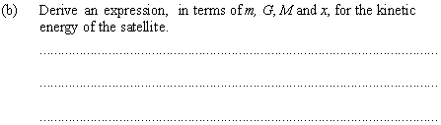
Topic D - Fields D.1 Gravitational fields (SL)
Solving problems involving gravitational field
x
R
∙From (a) v ² = GM / x.
∙But E_{K} = (1/2)mv ².
∙Thus E_{K} = (1/2)mv² = (1/2)m(GM / x) = GMm / (2x).
Notes:
© 2006 By Timothy K. Lund

Slide 47
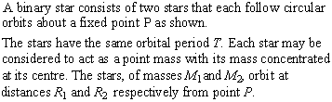

Topic D - Fields D.1 Gravitational fields (SL)
Solving problems involving gravitational force
R₂
R₁
M₁
M₂
P
∙It is the gravitational force.
Notes:
© 2006 By Timothy K. Lund

Slide 48
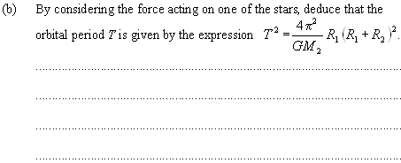
Topic D - Fields D.1 Gravitational fields (SL)
∙Note that F_{g} = GM₁M₂ / (R₁+R₂) ².
Solving problems involving gravitational force
R₂
R₁
M₁
M₂
P
∙M₁ experiences F_{C} = M₁v₁²/ R₁.
∙Since v₁ = 2πR₁/ T, then v₁² = 4π²R₁²/ T ².
∙Thus F_{C} = F_{G} → M₁v₁²/ R₁ = GM₁M₂ / (R₁+R₂) ².
M₁(4π²R₁²/ T ²) / R₁ = GM₁M₂ / (R₁+R₂) ²
4π²R₁(R₁+R₂) ² = GM₂T ²
4π²
GM₂
∙T ² = R₁(R₁+R₂) ²
Notes:
© 2006 By Timothy K. Lund

Slide 49
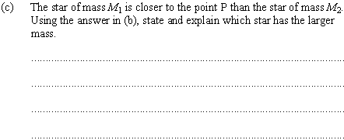
Topic D - Fields D.1 Gravitational fields (SL)
Solving problems involving gravitational force
R₂
R₁
M₁
M₂
P
∙From (b) T ² = (4π² / GM₂)R₁(R₁+R₂) ².
∙From symmetry T ² = (4π²/ GM₁)R₂(R₁+R₂) ².
(4π²/ GM₂)R₁(R₁+R₂) ² = (4π²/ GM₁)R₂(R₁+R₂) ²
(1 / M₂)R₁ = (1 / M₁)R₂
M₁ / M₂ = R₂ / R₁
∙Since R₂ > R₁, we see that M₁ > M₂.
Notes:
© 2006 By Timothy K. Lund

